Slide 1
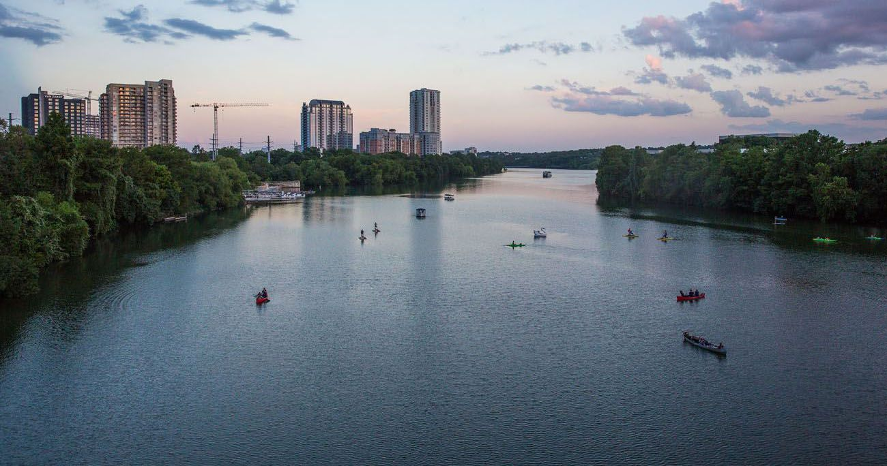

You and your Airbnb Pricing

Slide 2


Slide 3
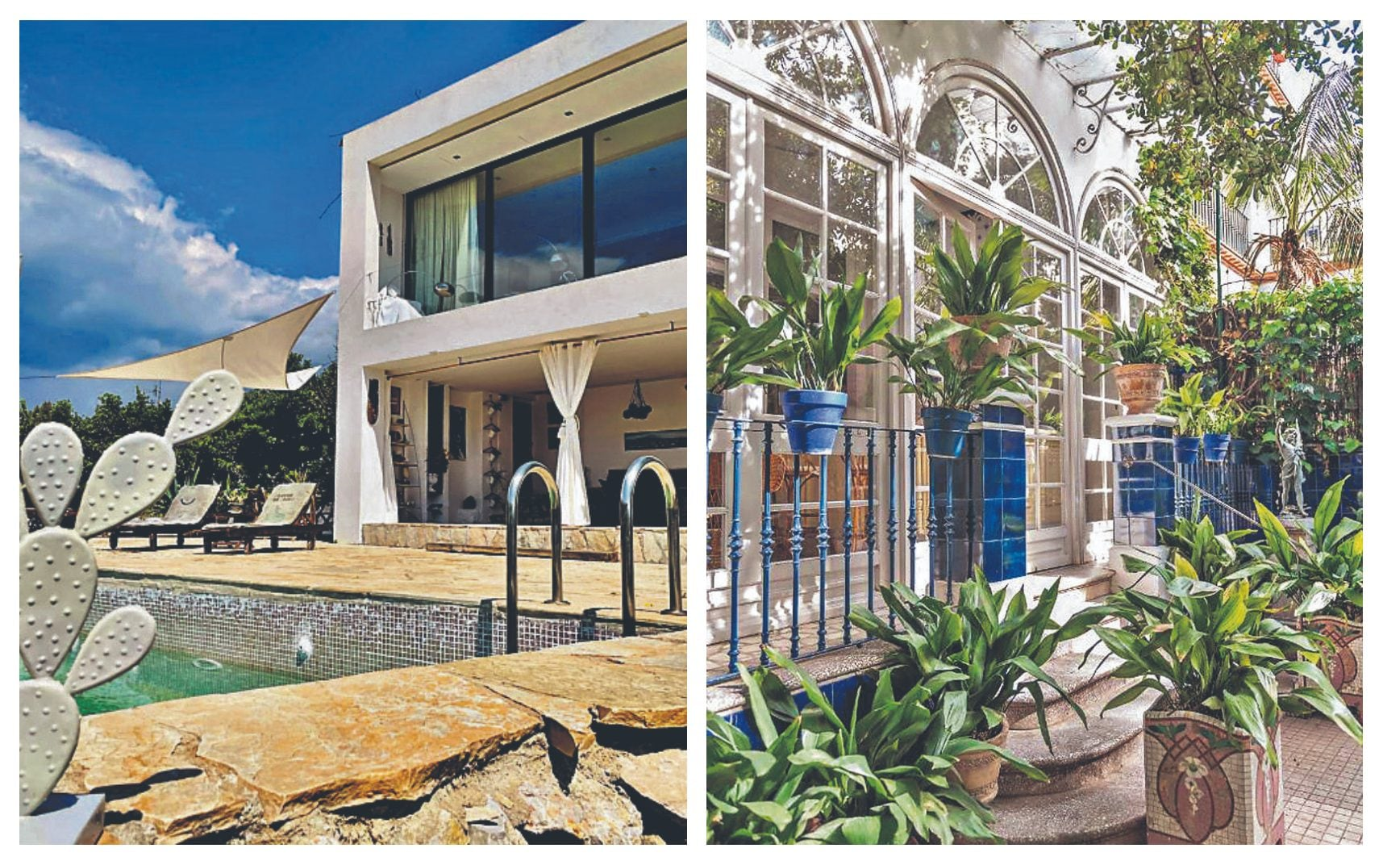
Why is Airbnb Pricing Important?
Hotel Price
Boston
$172 vs $397¹
Variety
Privacy
Become a Potential Earner
https://www.realsimple.com/work-life/travel/travel-planning/hotel-vs-airbnb-prices

Slide 4
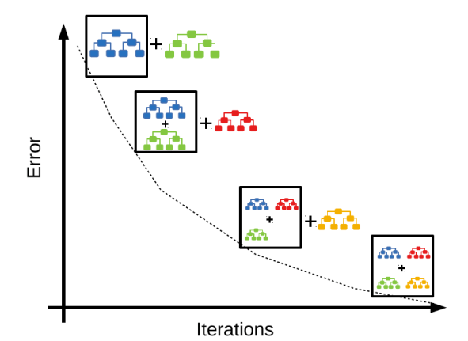
How Does the Model Work?
XGBoost Regressor
Ensemble of Decision Trees
Each tree improves on the previous
Reduces error
(predicted – real value)²

Slide 5

Model Description
Target Variable: Price
# of Predictors
Highlight predictors
# of People
Room Type
Property Type
Hot Tub?
Price Range from $10 - $10000

Slide 6
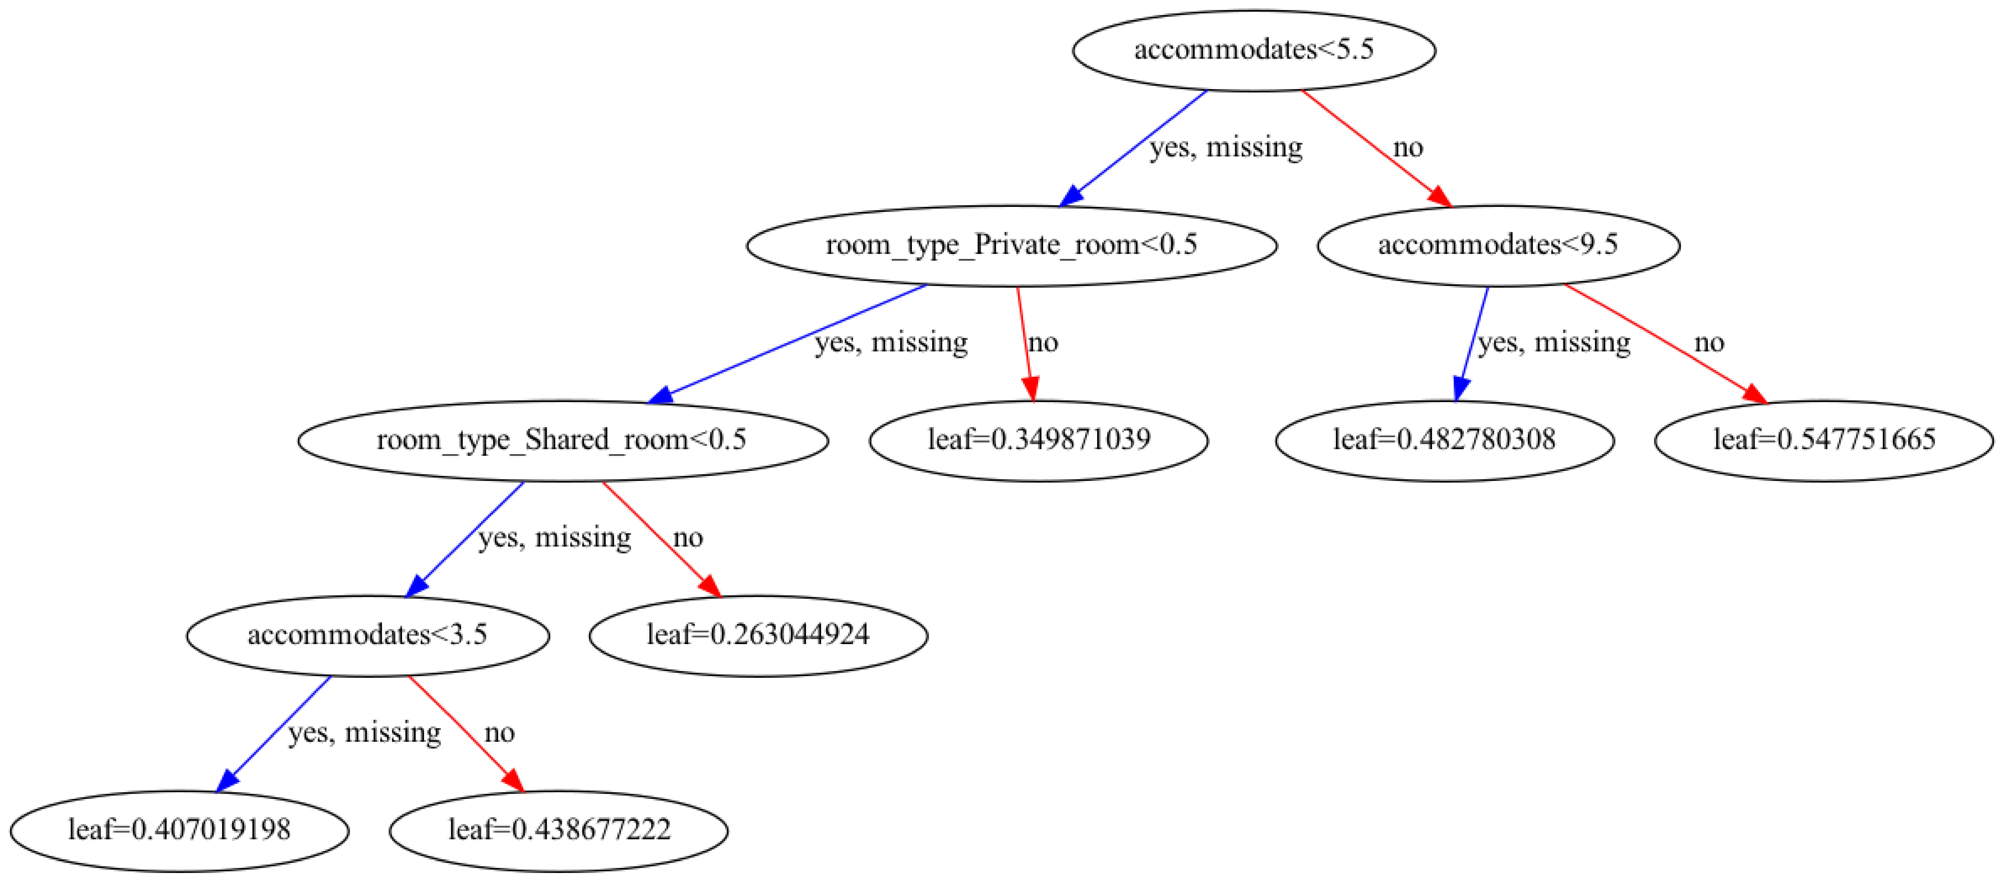

Slide 7
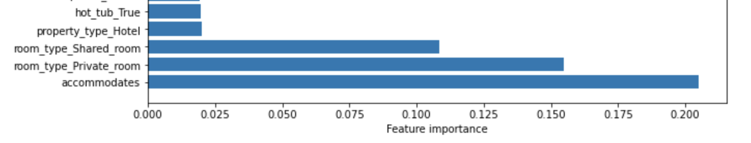
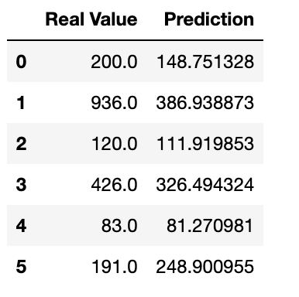
Result
65% variability explained by model
Important predictors
# of People
Private Room?
Shared Room?
Hotel?
Hot Tub

